Slide 1
Using Java Library Methods

Slide 2
Java Resources
When working on a programming problem, you should normally check to see if there are pre-built classes that meet your program's needs.
If there are such pre-built classes, then use those classes (don't "reinvent the wheel").
User input is complicated. The Scanner class handles user input. When you need user input in a program, use the Scanner class's input methods.
The Math class handles math calculations. When you need to perform non-trivial math calculations in a program, use the Math class's methods.

Slide 3
The Java API Library
Java's pre-built classes are stored in its class library, which is more commonly known as the Application Programming Interface (API) library.
Java's API classes are not part of the core Java language. For a program to use an API class, the class first needs to be imported into the program. For example: import java.util.Scanner;
The java.util thing that precedes Scanner is called a package, which is a group of classes.
The java.util package contains quite a few general-purpose utility classes. The only one you'll need for now is the Scanner class.

Slide 4
The Java Class Library
Some representative classes:
String
Random
Scanner
System
PrintStream
DecimalFormat and Number Format
Math
Wrapper Classes
JOptionPane

Slide 5
The java.lang package
Some classes are considered to be so important that the Java compiler automatically imports them for you here.
The Math class is one of those classes, so there's no need for you to import the Math class if you want to perform math operations.
The Java compiler automatically inserts this statement at the top of every Java program:
import java.lang.*;
The asterisk is a wild card and it means that all classes in the java.lang package are imported, not just the Math class.

Slide 6
How to use an API class
To use an API class, you don't need to know the internals of the class; you just need to know how to "interface" with it.
To interface with a class, you need to know how to use the methods within the class. For example, to perform input, you need to know how to use the Scanner class's methods - next, nextLine, nextInt, nextDouble, etc.
To use a method, you need to know what type of argument(s) to pass to it and what type of value it returns.
The standard way to show that information is to show the method's source code heading.

Slide 7


public int nextInt();
The arguments that you pass to the method would go inside the parentheses (but no arguments are passed to the nextInt method).
The return type (int in this example) indicates the type of the value that's being returned from the method.
All the methods in the API library are public, which means that they are accessible from everywhere; i.e., the "public" can access them.
Call the method: int days = stdIn.nextInt();

Slide 8
API headings
Source code headings for API methods are commonly referred to as API headings. Examples:
public static int abs(int num)
Returns the absolute value of num.
public static double abs(double num)
Returns the absolute value of num.
public static int max(int x, int y)
Returns the larger value of x and y.
public static double max(double x, double y)
Returns the larger value of x and y.

Slide 9
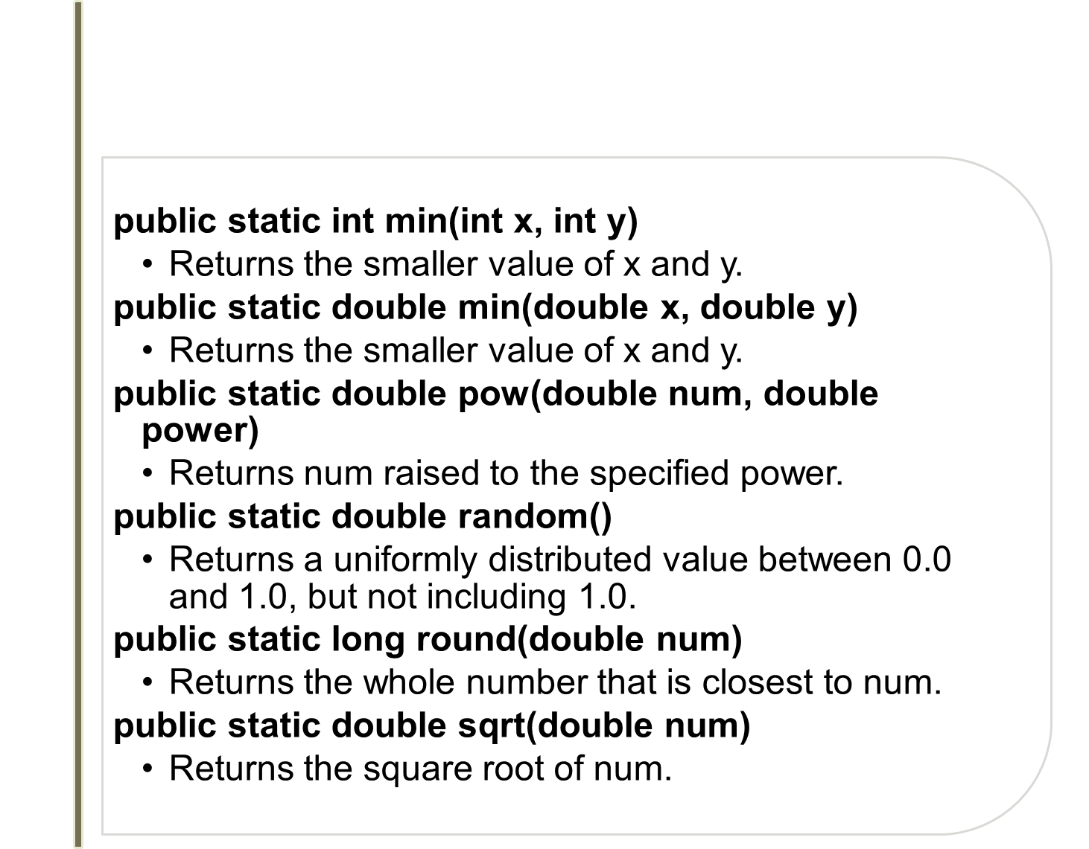
Math class API headings

Slide 10
The Math Class uses Static Methods
All the methods in the Math class are static methods (also called class methods), which means they are called by prefacing the method's name with the name of the class in which they are defined.
int position1 = 15, position2 = 18;
int distanceApart = Math.abs(position1 - position2);
Write a Java statement that updates x's value so x gets the absolute value of its original value.
x = Math.abs(x);

Slide 11
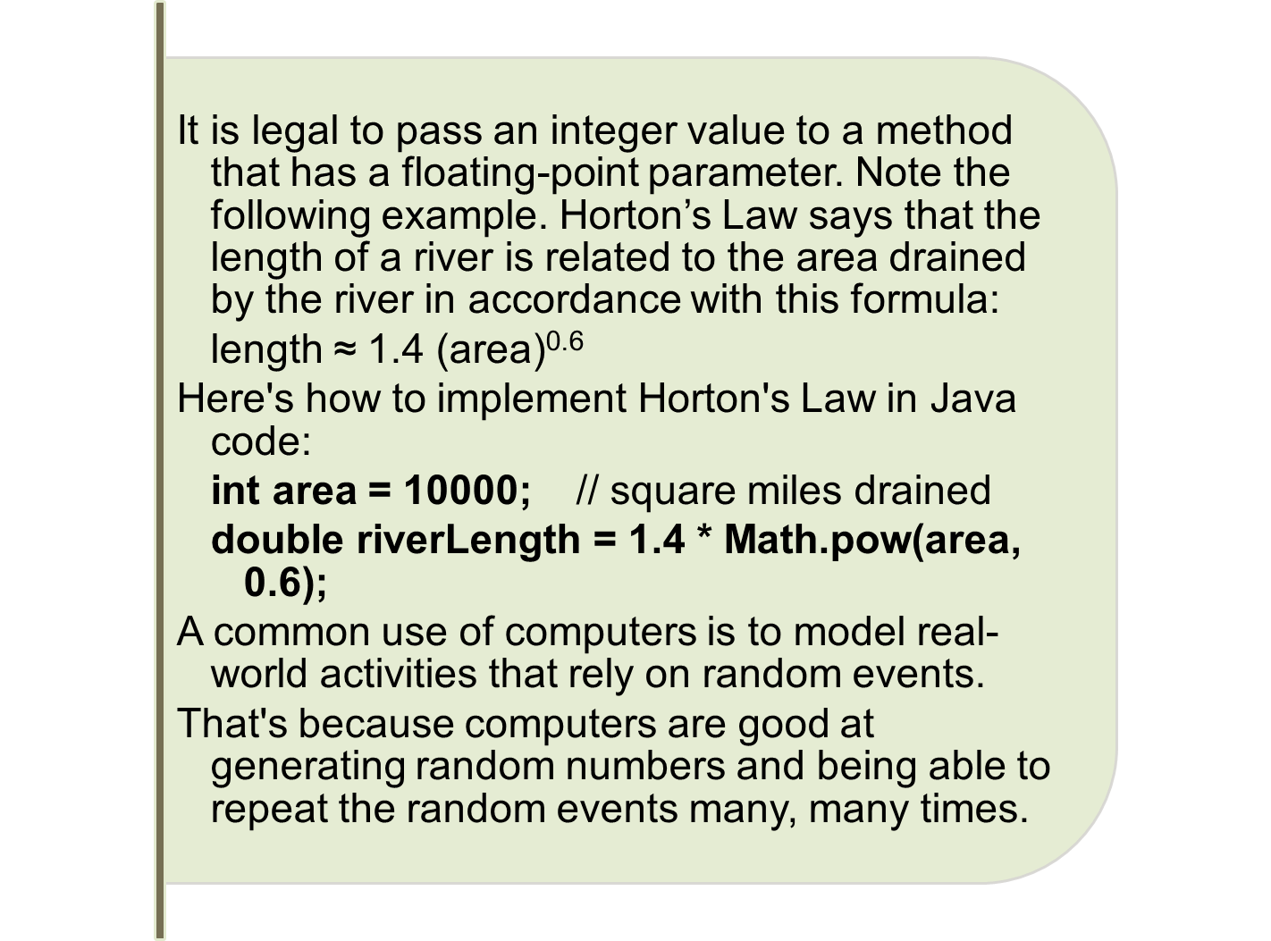
Math.pow
It’s OK to pass an int (area), into pow, which has a double parameter.

Slide 12
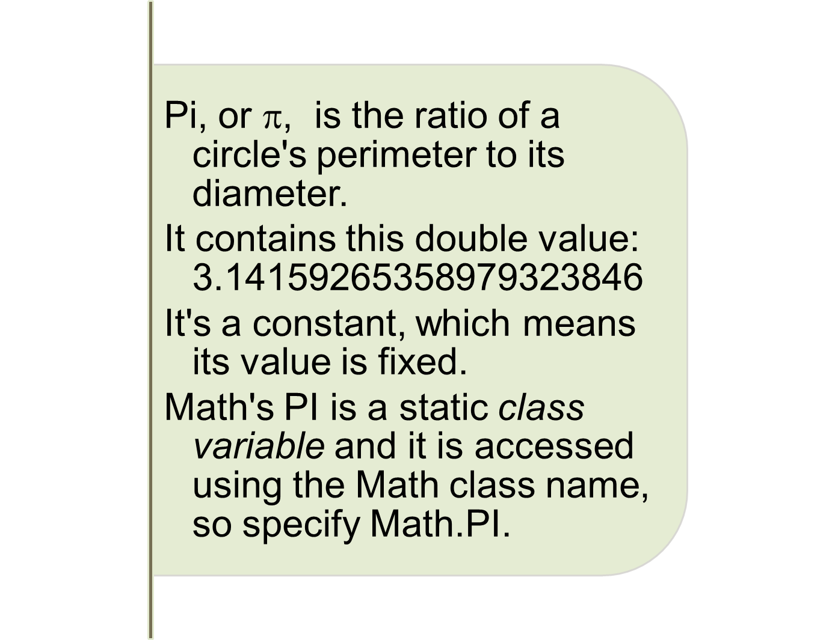
The Math class contains PI

